Slide 1


Program Synthesis with Types
Peter-Michael Osera
http://www.cis.upenn.edu/posera
posera@cis.upenn.edu

Slide 2
Verification
Optimization
Types:
What are they good for?
Program Design

Slide 3
“My program writes itself!”
(a.k.a. type-directed programming)
t1 -> t2 ~~> let f (x:t1) : t2 = 
C ~~> (g . f) 
(f : A -> B, g : B -> C)
How can we mechanize this reasoning?

Slide 4
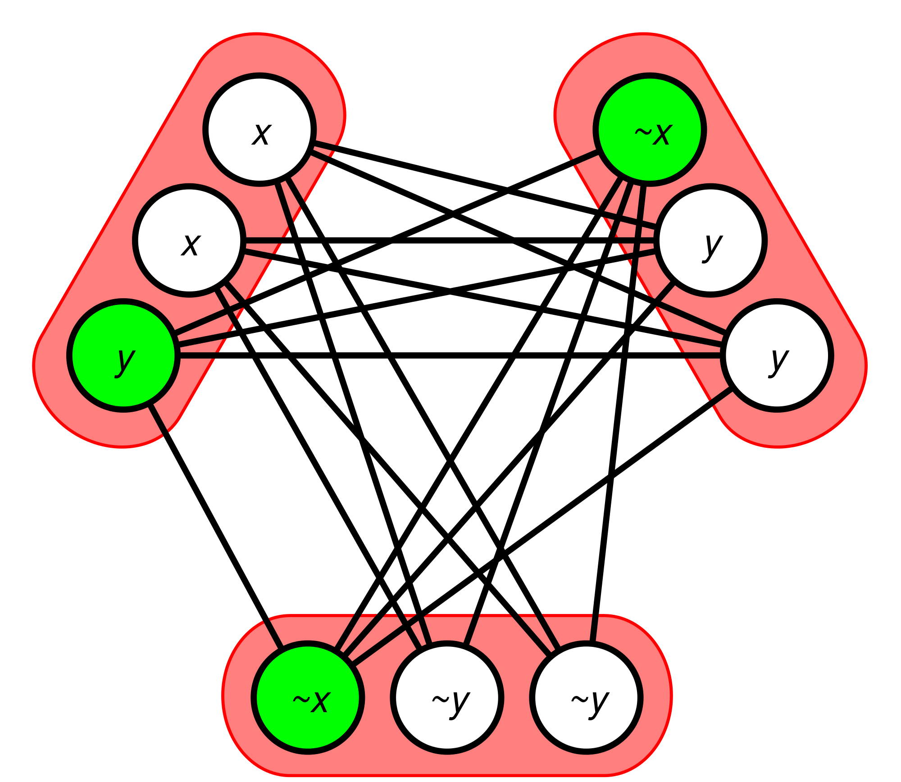
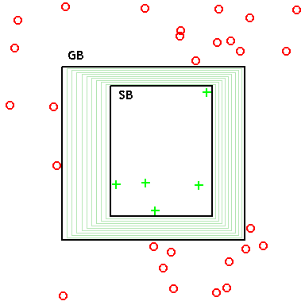
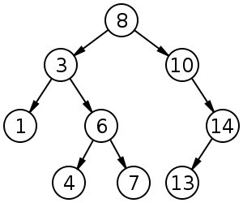
Program Synthesis
Program Search + Specification
Formal methods: SMT solvers, model checking, CEGIS
[Solar-Lezama; Kneuss; Bodik, Torlak; Gulwani; ...]
Machine Learning: version space algebras, genetic prog.
[Lau; Weimer; O’Neill and Briggs, ...]
AI/Logic: enumerative/syntactic search
[Green (1969), Summers (1976), Kitzelmann; Albarghouthi, Kincaid; Kuncak, Piscak; Feser, Chaudhuri, Dillig; Scherer and Rèmy, ...]
Notes:
Expand on this with citations and explicit mentions of successes in this area.
Brute-force search: earliest 70s work, that logic programming thing, Escher
Version space algebras: Tessa Lau’s work, software engineering auto-completion work
SMT solvers: Sketch, Leon
Probably break out the “types and proof theory declaration” out onto a separate slide.

Slide 5
λ
Type Theoretic Foundations
Synthesize progs. w/ rich types.
Types + proof theory ⇒ optimized search.
Metatheory of synthesis with types.

Slide 6
1,949,031,274
Untyped Programs
“Pruning the Search Space”
201,998
Typed Programs
21,704
Typed, Normal Programs

Slide 7
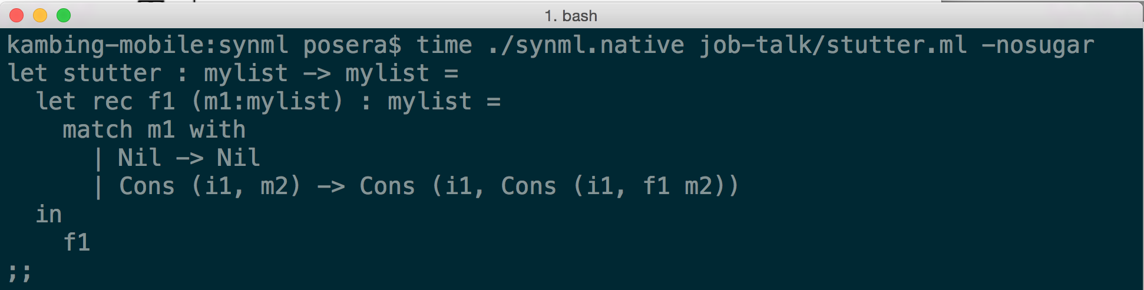
Myth, a program synthesizer for typed, functional programs (OCaml).
(MYTH DEMO)

Slide 8
Program Synthesis with Types
Foundations:
λ_{syn}: STLC + extensions
ML_{syn}*: Core ML (recursion, ADTs)
λ∀_{syn}: System F
Metatheory: soundness & completeness.
Implementation: Myth.*
*[PLDI 2015]

Slide 9
(One type per expression)
Inputs
Output*
⇒ Typechecking algorithm
(Derivation →Well-typed Program)

Slide 10
λ_{syn}
(Types)
(Terms)

Slide 11
(Many expressions per type)
Inputs
Output
⇒ Well-typed term generation procedure
(Derivation → Enumerated Program)

Slide 12
Enumerate a term e of type τ.

Slide 13

How do we avoid enumerating non-normal forms?

Slide 14
Introduction Forms: I
Elimination Forms: E

Slide 15
(Elim Forms)
(Intro Forms)

Slide 16
Introduction Forms: I
Type-Directed
Example Refinement
Guess-and-Check
Elimination Forms: E

Slide 17
Examples in λ_{syn}
?? ?? ??
(Values)
(Example Values)
Partial Function Value
Ex. c₁ ⇒ c₁ | c₂ ⇒ c₂
Example World
Environment
Example value

Slide 18
Inputs
Output
⇒ Type-and-example refinement procedure
(Derivation → Satisfying Program)

Slide 19
...Synthesize that goal
Same goal value...

Slide 20
Input
Output
m input/output examples →
m new example worlds*
Ex. c₁ ⇒ c₁ | c₂ ⇒ c₂ ⇝
[c₁/x] ↦ c₁ | [c₂/x] ↦ c₂
*(Note: specialized to a single partial function.)

Slide 21
λ_{syn}
ML_{syn}
Recursion and algebraic data types.
λ∀_{syn}

Slide 22
ML_{syn}
(1) Type-directed Refinement
(2) Guess-and-check
Breadth-first search for valid derivations.
⇒
Synthesize the smallest satisfying program.
(3) Learning via pattern matching

Slide 23
stutter : list -> list
■ : list -> list
Context
Goal Examples:
[] => []
[0] => [0, 0]
[1, 0] => [1, 1, 0, 0]

Slide 24
stutter : list -> list
let rec stutter (l:list) : list =
■ : list
Context
Goal Examples:
[] => []
[0] => [0, 0]
[1, 0] => [1, 1, 0, 0]

Slide 25
stutter : list -> list
let rec stutter (l:list) : list =
■ : list
Example Worlds
Context
l=[]
l=[0]
l=[1, 0]
Goal Examples:
[]
[0, 0]
[1, 1, 0, 0]

Slide 26
stutter : list -> list
let rec stutter (l:list) : list =
l
*We don’t generate stutter l – syntactic restriction on recursive calls.
Context
l=[]
l=[0]
l=[1, 0]
Goal Examples:
[]
[0, 0]
[1, 1, 0, 0]

Slide 27
stutter : list -> list
let rec stutter (l:list) : list =
let rec stutter (l:list) : list =
match l with
| Nil ->  : list
| Cons (x, l’) ->  : list
Context
l=[]
l=[0]
l=[1, 0]
Goal Examples:
[]
[0, 0]
[1, 1, 0, 0]

Slide 28
stutter : list -> list
let rec stutter (l:list) : list =
let rec stutter (l:list) : list =
match l with
| Nil ->  : list
| Cons (x, l’) ->  : list
Context
l=[]
Goal Examples:
[]

Slide 29
stutter : list -> list
let rec stutter (l:list) : list =
let rec stutter (l:list) : list =
match l with
| Nil -> Nil
| Cons (x, l’) ->  : list
Context
l=[]
Goal Examples:
[]

Slide 30
stutter : list -> list
let rec stutter (l:list) : list =
let rec stutter (l:list) : list =
match l with
| Nil -> Nil
| Cons (x, l’) ->  : list
Context
l=[0], ...
l=[1, 0], ...
Goal Examples:
[0, 0]
[1, 1, 0, 0]

Slide 31
stutter : list -> list
let rec stutter (l:list) : list =
let rec stutter (l:list) : list =
match l with
| Nil -> Nil
| Cons (x, l’) ->  : list
Context
l=[0], x=0, l’=[]
l=[1, 0], x=1, l’=[0]
Goal Examples:
[0, 0]
[1, 1, 0, 0]

Slide 32
stutter : list -> list
let rec stutter (l:list) : list =
let rec stutter (l:list) : list =
match l with
| Nil -> Nil
| Cons (x, l’) ->
Cons (x, Cons (x,  : list))
want: stutter l’
try: l, l’, ...
Context
l=[0], x=0, l’=[]
l=[1, 0], x=1, l’=[0]
Goal Examples:
[]
[0, 0]

Slide 33
stutter : list -> list
let rec stutter (l:list) : list =
let rec stutter (l:list) : list =
match l with
| Nil -> Nil
| Cons (x, l’) ->
Cons (x, Cons (x, stutter l’))
stutter=( [] => [] | [0] => [0, 0]
| [1, 0] => [1, 1, 0, 0] )
Context
l=[0], x=0, l’=[]
l=[1, 0], x=1, l’=[0]
Goal Examples:
[]
[0, 0]

Slide 34
stutter : list -> list
let rec stutter (l:list) : list =
let rec stutter (l:list) : list =
match l with
| Nil -> Nil
| Cons (x, l’) ->
Cons (x, Cons (x, stutter l’))
stutter [] = []
stutter=( [] => [] | [0] => [0, 0]
| [1, 0] => [1, 1, 0, 0] )
Context
l=[0], x=0, l’=[]
l=[1, 0], x=1, l’=[0]
Goal Examples:
[]
[0, 0]

Slide 35
stutter : list -> list
let rec stutter (l:list) : list =
let rec stutter (l:list) : list =
match l with
| Nil -> Nil
| Cons (x, l’) ->
Cons (x, Cons (x, stutter l’))
stutter [0] = [0, 0]
stutter=( [] => [] | [0] => [0, 0]
| [1, 0] => [1, 1, 0, 0] )
Context
l=[0], x=0, l’=[]
l=[1, 0], x=1, l’=[0]
Goal Examples:
[]
[0, 0]

Slide 36
stutter : list -> list
let rec stutter (l:list) : list =
let rec stutter (l:list) : list =
match l with
| Nil -> Nil
| Cons (x, l’) ->
Cons (x, Cons (x, stutter l’))
stutter=( [] => [] | [0] => [0, 0]
| [1, 0] => [1, 1, 0, 0] )
Context
l=[0], x=0, l’=[]
l=[1, 0], x=1, l’=[0]
Goal Examples:
[]
[0, 0]
“Trace Completeness”
e.g., [1, 0] ⟶ [0] ⟶ []

Slide 37
λ∀_{syn}
Polymorphic Type
Polymorphic Value
?? ?? ??
Ex. Λα. …

Slide 38
Examples in λ∀_{syn}
Polymorphic Example Value
Polymorphic Constant
Ex. Λq₁, q₂:α.
| [ ] ⇒ [ ]
| [q₁] ⇒ [q₁,q₁]
| [q₂, q₁] ⇒ [q₂,q₂,q₁,q₁]

Slide 39
Alternative Example Form in λ∀_{syn}
Polymorphic
Instantiation
Ex. [int]
| [ ] ⇒ [ ]
| [0] ⇒ [0, 0]
| [1, 0] ⇒ [1, 1, 0, 0]
Polymorphic Example Values
≡
Polymorphic Instantiation

Slide 40
The Metatheory of Program Synthesis with Types
Soundness
(Type Soundness)
(Example Soundness)
Completeness

Slide 41


Soundness
Completeness
λ_{syn}
ML_{syn}
Treating input/output examples as plain values.
λ∀_{syn}

Slide 42
Typechecking ⇒ Synthesis
Higher-order functions, ADTs, and recursion.
EGUESS-VAR
stutter
EGUESS-VAR
l’
EGUESS-APP
■ 
IREFINE-GUESS
EGUESS-VAR
x
IREFINE-BASE
Cons(, )
IREFINE-BASE
Nil
EGUESS-VAR
x
IREFINE-BASE
Cons(, )
IREFINE-MATCH
match l with Nil ->  | Cons (x, l’) -> 
IREFINE-ARR
let rec stutter (l:list) : list = 

Slide 43
(3) Proof Search Techniques
Generating normal forms
Relevant term generation
Caching example refinements (refinement trees)
EGUESS-VAR
stutter
EGUESS-VAR
l’
EGUESS-APP
■ 
IREFINE-GUESS
EGUESS-VAR
x
IREFINE-BASE
Cons(, )
IREFINE-BASE
Nil
EGUESS-VAR
x
IREFINE-BASE
Cons(, )
IREFINE-MATCH
match l with Nil ->  | Cons (x, l’) -> 
IREFINE-ARR
let rec stutter (l:list) : list = 

Slide 44
Algorithmic Insight: Relevance Logic ⇒ Caching
“Generate type τ E-forms in context Γ with size n”
x relevant
(must be used)
x irrelevant
(not used)
cacheable

Slide 45
Implementing Relevance
“Generate type τ E-forms that definitely mention x in context Γ with size n”

Slide 46
Refinement Trees
EGUESS-VAR
stutter
EGUESS-VAR
l’
= Determined by types and examples.
EGUESS-APP
■ 
= Possible shapes of programs.
IREFINE-GUESS
Compute RTree
E-Guess
EGUESS-VAR
x
IREFINE-BASE
Cons(, )
IREFINE-BASE
Nil
EGUESS-VAR
x
IREFINE-BASE
Cons(, )
IREFINE-MATCH
match l with Nil ->  | Cons (x, l’) -> 
IREFINE-ARR
let rec stutter (l:list) : list = 

Slide 47
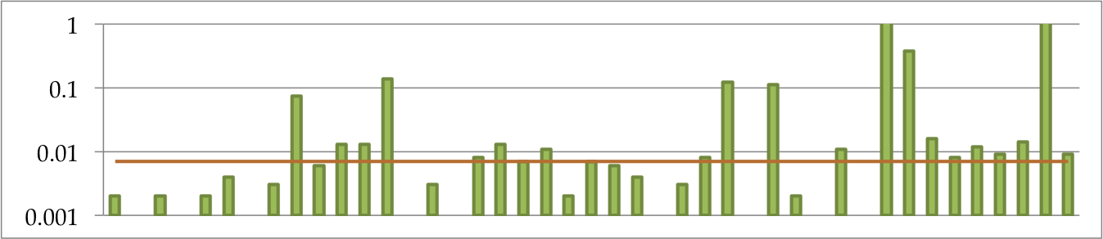
(Median: 0.07s)
Time (s)
Bool
List
Nat
Tree
Evaluation: 43 benchmarks tests.
“Intro FP programs”: bools, lists, nats, and trees.
Purpose of evaluation—exploration:
What is the performance?
How many examples are necessary to generate good results?
Median runtime: 0.07s.
Average #/examples: 6.
Average program size: 13.

Slide 48
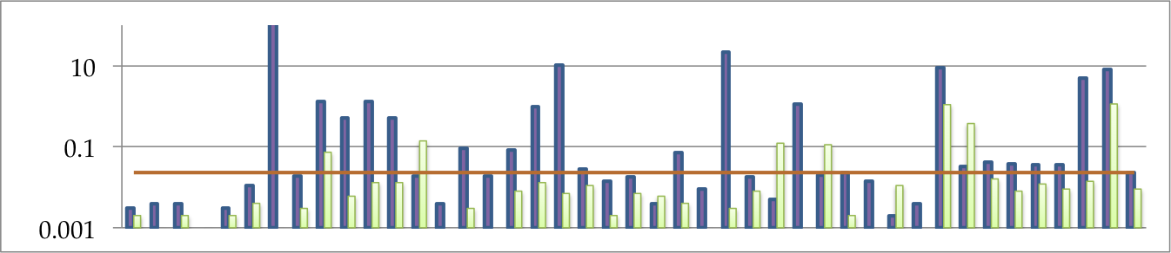
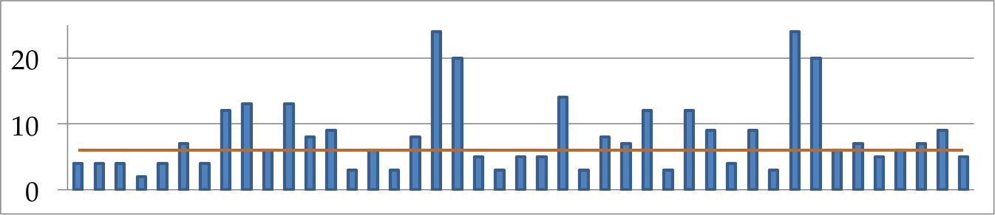
(Median: 0.023s)
Time (s)
Synthesis in larger contexts is challenging!
Outs: equivalences, richer types, e.g., polymorphism.
(Median: 6 examples)
#/ex.
Reigning in #/examples requires additional info.
Ex. taking advantage of the program being synthesized...

Slide 49
Calculator interpreter.
(22 examples, size 47, 11s)
let arith : exp -> nat =
let rec f1 (e1:exp) : nat =
match e1 with
| Const (n1) -> n1
| Sum (e2, e3) -> sum (f1 e2) (f1 e3)
| Prod (e2, e3) -> mult (f1 e2) (f1 e3)
| Pred (e2) -> (match f1 e2 with
| O -> 0
| S (n1) -> n1)
| Max (e2, e3) -> (match compare (f1 e2) (f1 e3) with
| LT -> f1 e3
| EQ -> f1 e3
| GT -> f1 e2)
in
f1
;;

Slide 50
^{let fvs_large : exp -> list =}
^{let rec f1 (e1:exp) : list =}
^{match e1 with}
^{| Unit -> Nil}
^{| BVar (n1) -> Cons (n1, Nil)}
^{| FVar (n1) -> Nil}
^{| Lam (n1, e2) -> f1 e2}
| App (e2, e3) -> append (f1 e2) (f1 e3)
| Pair (e2, e3) -> append (f1 e2) (f1 e3)
^{| Fst (e2) -> f1 e2}
^{| Snd (e2) -> f1 e2}
^{| Inl (e2) -> f1 e2}
^{| Inr (e2) -> f1 e2}
| Match (e2, n1, e3, n2, e4) ->
^{(match f1 e2 with}
| Nil -> append (f1 e3) (f1 e4)
^{| Cons (n3, l1) ->}
^{Cons (n3,} ^{append (f1 e3 (f1 e4)))}
^{| Const (n1) -> Nil}
| Binop (e2, b1, e3) -> append (f1 e2) (f1 e3)
^{in}
^{f1}
;;
Free variable collector for a lambda calculus.
(31 examples, size 75, 3.9s)

Slide 51
let list_pairwise_swap : list -> list =
let rec f1 (l1:list) : list =
match l1 with
| Nil -> []
| Cons (n1, l2) ->
(match f1 l2 with
| Nil ->
(match l2 with
| Nil -> []
| Cons (n2, l3) ->
Cons (n2, Cons (n1, f1 l3)))
| Cons (n2, l3) -> [])
in
f1
;;
??
f1 l2 ≡
“Does l2 have
even length?”
Ex. [0, 1, 0, 1] ⇒ [1, 0, 1, 0]
[0, 1, 0] ⇒ []

Slide 52
Next Steps for Program Synthesis with Types
Synthesis with richer types
Linearity, refinements, dependency, ...
Additional forms of specification
Constraints, solvers, ...
Enumeration modulo equivalences
The biggest bottleneck...
Further Applications
From general-purpose synthesis to assistance...

Slide 53




David Walker
(Princeton)
Jonathan Frankle
(Princeton, UW)
Steve Zdancewic
Rohan Shah

Slide 54
Typechecking ⇒ Synthesis
Thesis (in less than a week...?)
https://github.com/psosera/thesis
Myth source code and examples
https://github.com/psosera/myth
http://www.cis.upenn.edu/~posera
posera@cis.upenn.edu
Thanks!

